Slide 1
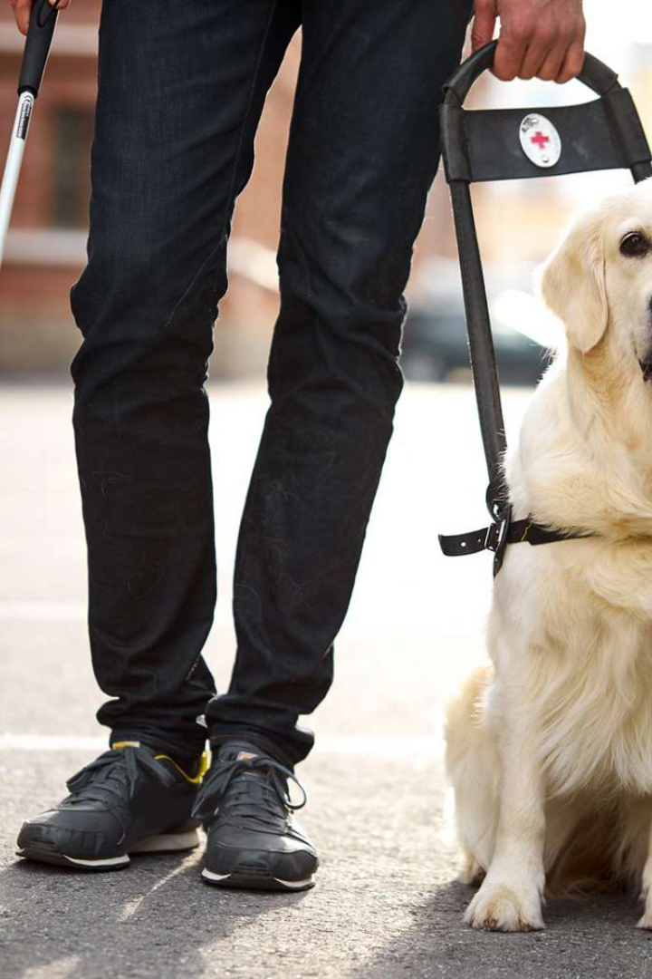

ML Model for Object Detection and Narration for Blind People
An overview of a machine learning model that detects objects and narrates them aloud to blind individuals, built using TensorFlow's DNN model on IBM LinuxOne community cloud with the integration of coco dataset.

Slide 2

Introduction to the ML Model
Discover the purpose and benefits of the ML model designed specifically to aid blind people in object detection and narration.

Slide 3

Technical Details of the ML Model
Learn about the utilization of TensorFlow's DNN model for accurate object detection, the training process on IBM LinuxOne community cloud, and the integration with the comprehensive coco dataset.

Slide 4

Functionality and Features
Explore how the ML model detects objects using advanced algorithms like Deep Neural Network and the mechanism behind narrating the objects to visually impaired individuals in a comprehensive and intuitive manner.

Slide 5
Real-World Applications and Impact
Discover the various examples illustrating the practical use of the ML model in everyday life and how it positively affects blind individuals, empowering them for greater independence and engagement.

Slide 6
Potential Future Developments and Enhancements
Delve into the possibilities of future advancements and enhancements for the ML model, aiming to further improve accuracy, expand functionality, and cater to specific needs of blind individuals.

Slide 7

Team Members
Priya Nandi
Nisarga GR
Raj Goyal
Srimanth D
Rahul
Bhuvana Reddy

